Slide 1


LA Crime Analysis
Kenway, Michael, Ritika
Notes:
Hello and Good evening everybody, today our group – Kenway, Michael and I are going to present our topic on the LA Crime Analysis. Our Team Name is “The Crime Busters.”

Slide 2
Agenda
Introduce the topic, our goal (Kenway)
Show off the Flask Dashboard (Kenway)
Crime reports over the years (Ritika)
Top crimes committed in LA (Ritika)
Top crime by area (Michael)
Machine learning model (Michael)
Interactive map (Kenway)
Notes:
Okay, we are going to cover the following which includes introducing the topic, we will talk about our goals, and also the Interactive Map these three topics will be covered by Kenway. I will be talking about the Crime Reports over the years and the Top Crimes committed in LA. Michael will be talking about the top crimes committed by area and the Machine Learning model.

Slide 3
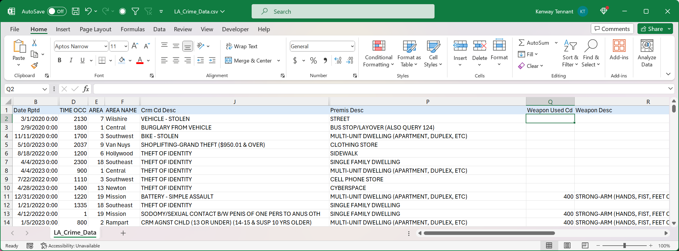
Introduction
Focus on Crime
Found last 4 years of crime data in LA from Kaggle
https://www.kaggle.com/datasets/chaitanyakck/crime-data-from-2020-to-present
Notes:
Our Project focused on Crime and we also found the last 4 years of crime data in LA from the Kaggle website.

Slide 4
Goals
How has crime in LA developed over the last 4 years?
What are the top crimes committed in LA?
What areas see the most crime activity?
We built
A handful of charts showing high level statistics
A Leaflet map comparing crime activity between areas
Machine Learning Model to predict crime activity
Notes:
Our goals focused on how has crime in LA developed over the last 4 years, what are the top crimes that were committed in LA, what areas see the most crime activity. We made several charts showing high level of statistics, we also made a Leaflet map comparing the crime activity between areas. We built the Machine Learning Model to predict some crime activity.

Slide 5
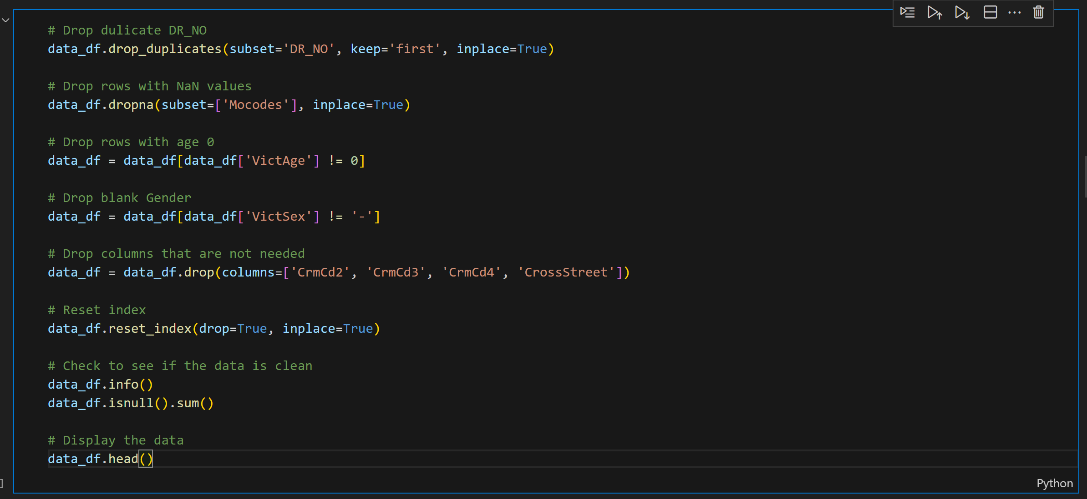
Data Cleaning
Transformed the clean data into the data folder: I opened the VS Code app and started importing dependencies, I read in the data from the excel file using pandas. I also converted the data into a data frame using the df = pd.Dataframe(data).
I worked with the table that includes the DR_NO, Date Rptd, Date Occ and Time Occ.
Notes:
Kenway and I worked on Importing Dependencies and Data Cleaning on VS Code. This included transforming the clean data into the data folder. I opened the VS Code app and started importing dependencies, I read in the data from the excel file using Pandas. I worked with the table that includes the DR_NO, Date Rptd, Date Occ, and Time Occ.

Slide 6
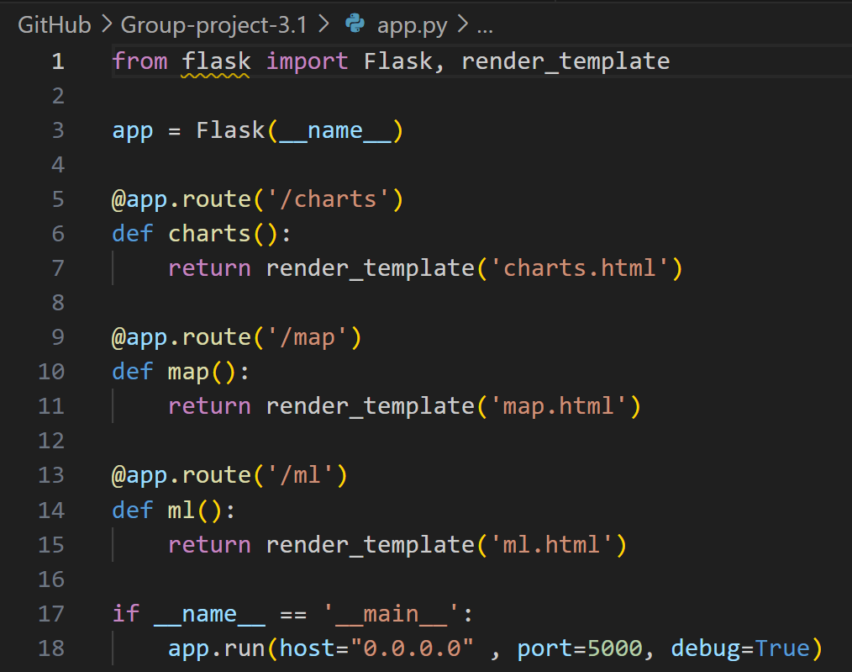
Show off the Flask Dashboard
We have created 3 sites showing off different parts of the project.
Charts: Handful of high-level statistic charts
http://192.168.0.63:5000/charts
Map: Hosts the interactive map
http://192.168.0.63:5000/map
Machine Learning: Hosts machine learning data
http://192.168.0.63:5000/ml
Notes:
Kenway worked with Showing off the Flask Dashboard – we have created 3 sites showing off different parts of the project. We included several charts that showed a handful of high-level statistic charts. We built an Interactive Map. We also worked with Machine Learning that included machine learning data.

Slide 7
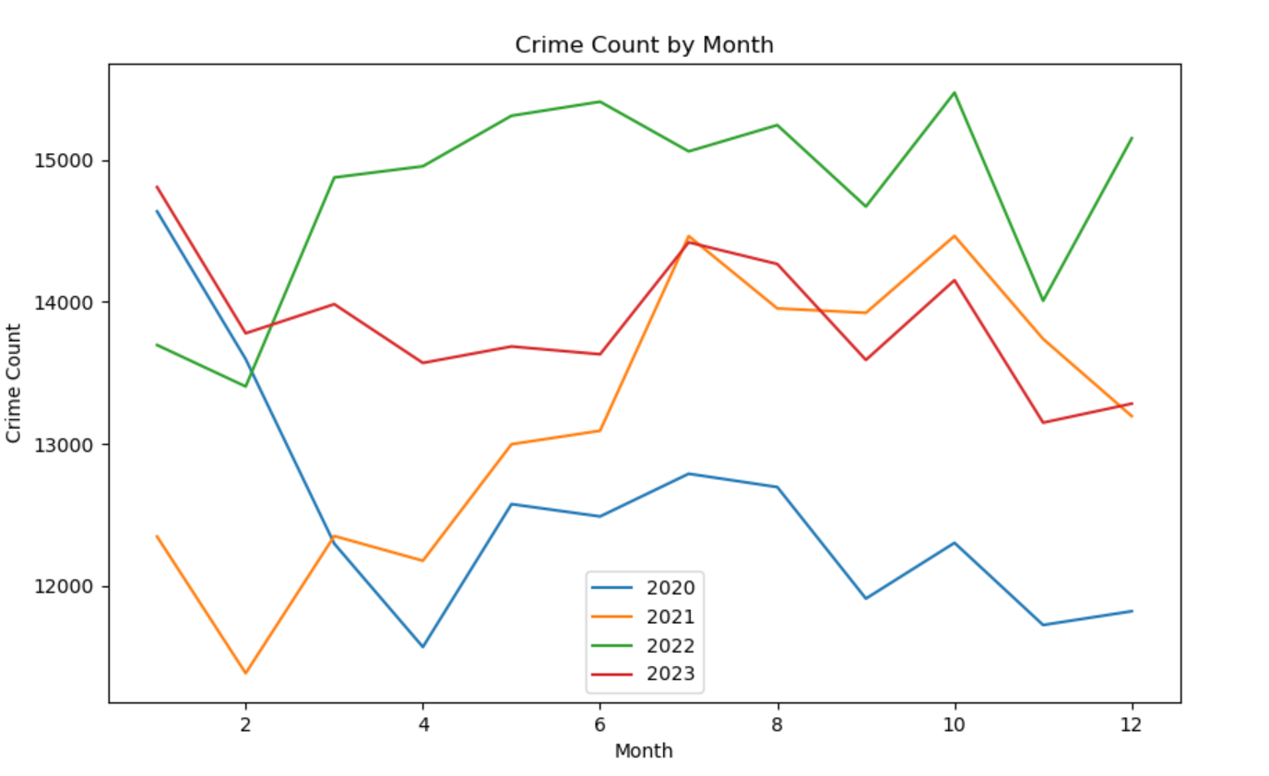
Crime Reports over the years
I accessed the dt accessor on the Series, not the DataFrame. I wrote all these functions on VS Code. I counted the crime of each month; this also includes taking the crime count average of each month from the year 2020. Then, I displayed the data using the function.
I plotted a graph based on this information using the Matplotlib function.
Notes:
In the Crime Reports over the Years, I accessed the dt accessor on the Series, not the DataFrame. I wrote all these functions on VS Code. I also counted the crime of each month from the year 2020. Then, I displayed the data using the crime_count_2023 function. The picture on the right-hand side shows a graph on the Crime Count by Month. We can see that we have 4 peaks in the month of October, that means there was a lot of crime during that time. There was crime on Halloween, the crime was lower than average.

Slide 8
Crime Report over the years (Ctnd.)
Under the October Analysis, I did some isolating of the October month. I sorted each df by the date. Then, I reset the index. I got the value count for each year, I also did some renaming of the columns to be more consistent.
Then, I finally printed a DataFrame. I got the table of the Date and Crime Count. Using this DataFrame, I plotted a graph of the Daily Crime Count for October 2023.
Couldn’t find any reason why there would be a spike in October.
Notes:
Under the October Analysis, I did some isolating of the October month. I sorted each df by the date. Then, I reset the index. I got the value count for each year, I also did some renaming of the columns to be more consistent.

Slide 9
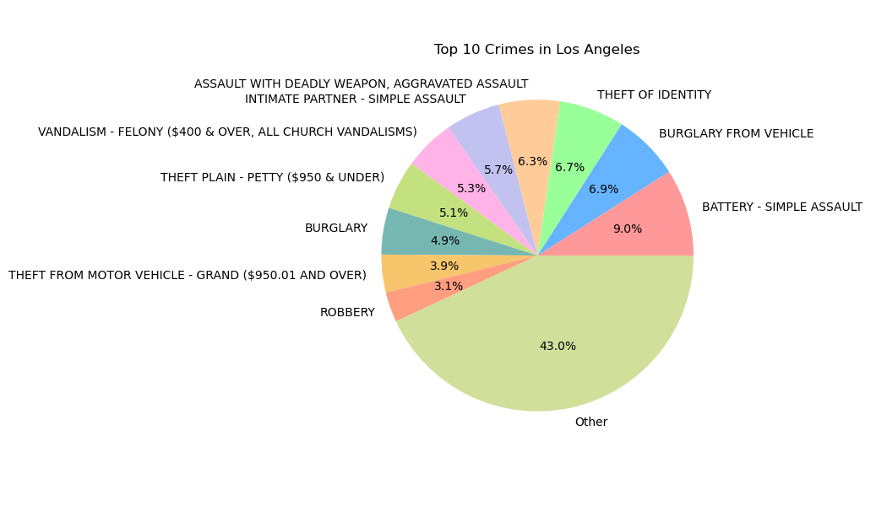
Top Crimes committed in LA
I created a data frame that contains the top 10 crimes. I got a table which includes the Crime and Count columns.
I plotted a graph showing the top 10 crimes using plt bar. I also created a data frame that excludes the top 10 crimes with the two columns of Crime and Count.
Notes:
Talking about the top crimes committed in LA, I created a data frame (top_crime_df) that contains the top 10 crimes. I plotted a graph showing the top 10 crimes using plt bar. I also created a data frame that excludes the top 10 crimes with the two columns of Crime and Count.

Slide 10
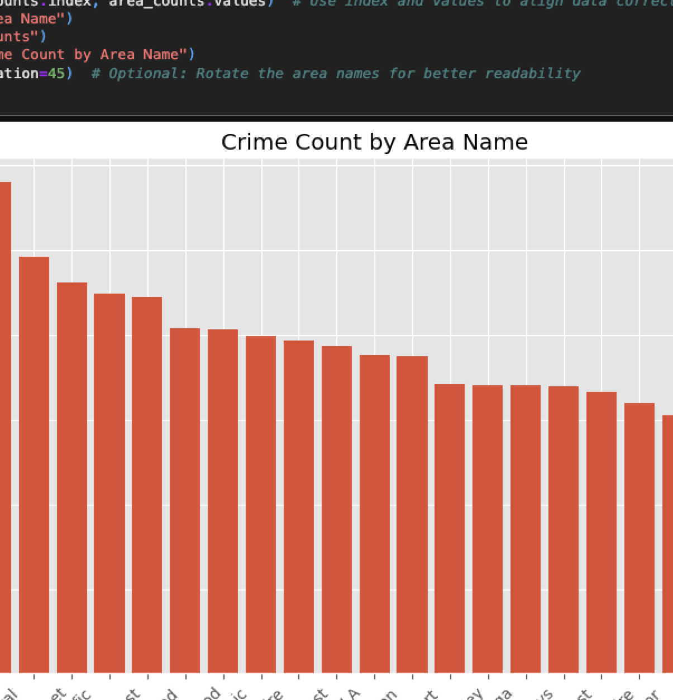
Top Crimes committed by Area
In this section, we analyzed the Top Crimes in Los Angeles. We imported the data using os, csv, pandas, numpy, and matplotlib. We checked in for the number of null values across the data frame. There was also renaming of the table which has the Column, Non-Null Count and the Dtype for better readability. We converted the Datetime column to Datetime. We also removed the H value of Vict_Sex from the Non-Null Count table. We also needed to find out the top 10 crime locations.
We also had to calculate the value counts and plot a chart which is called Crime Count by Area Name.
Notes:
In this section, we analyzed the Top Crimes in Los Angeles. We imported the data using os, csv, pandas, numpy, and matplotlib. We checked in for the number of null values across the data frame. There were also renaming of the table which has the Column, Non-Null Count and the Dtype for better readability. We converted the Datetime column to Datetime. We also removed the H value of Vict_Sex from the Non-Null Count table. We also had to calculate the value counts and plot a chart which is called Crime Count by Area Name.

Slide 11
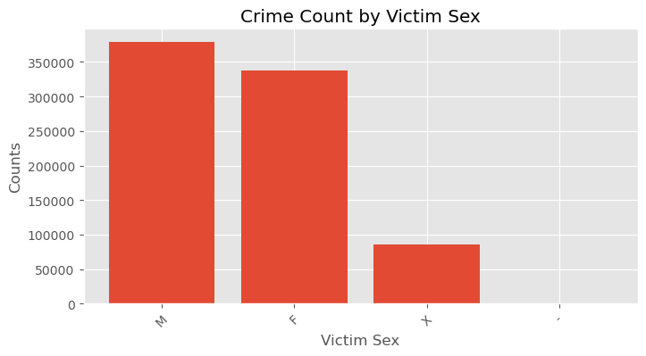
Top Crimes committed by Area (Ctnd.)
Based on the graph above, we needed to figure out a couple of things such as number of crime descriptions and what type of crime was committed.
We also had to calculate the value counts for the Vict_Descent Column, do some plotting and rotate labels if necessary for better readability if there are many categories.
Renamed columns as needed
Notes:
Based on the graph above, we needed to figure out a couple of things such as number of crime descriptions and what type of crime was committed. We also had to calculate the value counts for Vict_Descent Column, do some plotting and rotate labels if necessary for better readability if there are many categories.

Slide 12
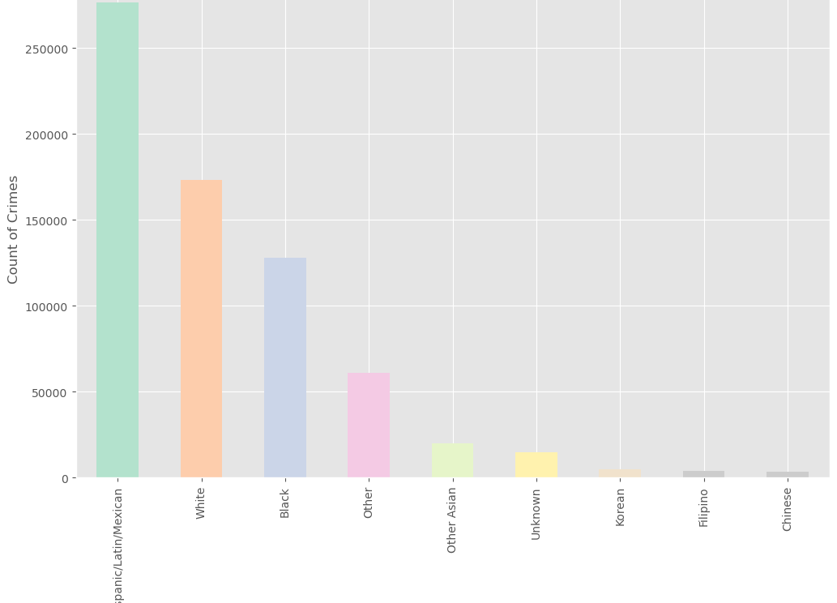
Top Crimes committed by Area
We plotted a graph on the Victims Categorization by Ethnicity, and we used this function:
Notes:
We plotted a graph on the Victims Categorization by Ethnicity, and we used this function.

Slide 13
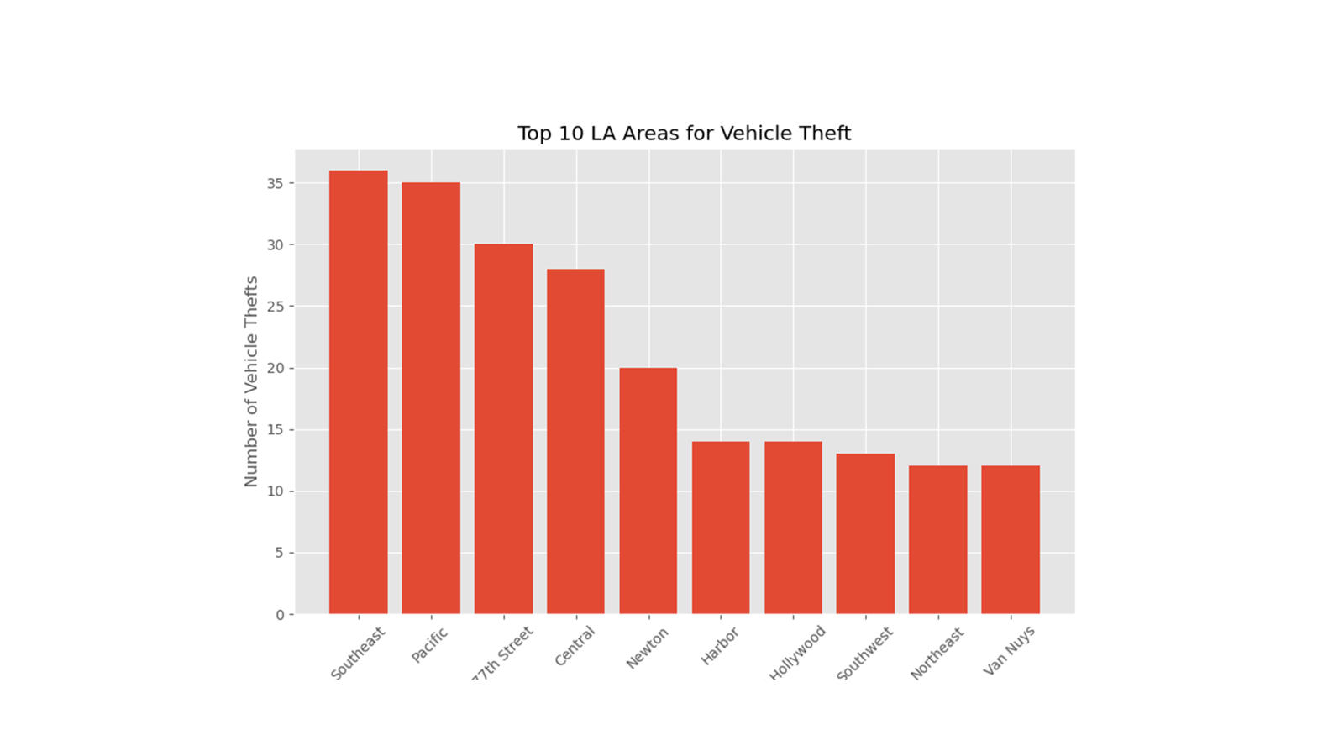
LA Vehicle Theft

Slide 14
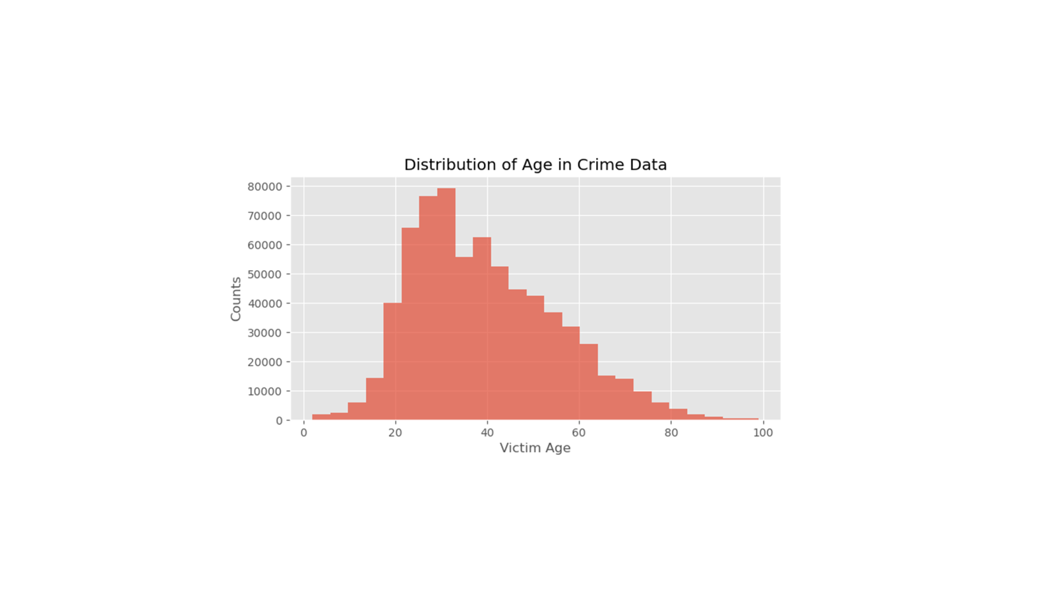
Victims age distribution

Slide 15
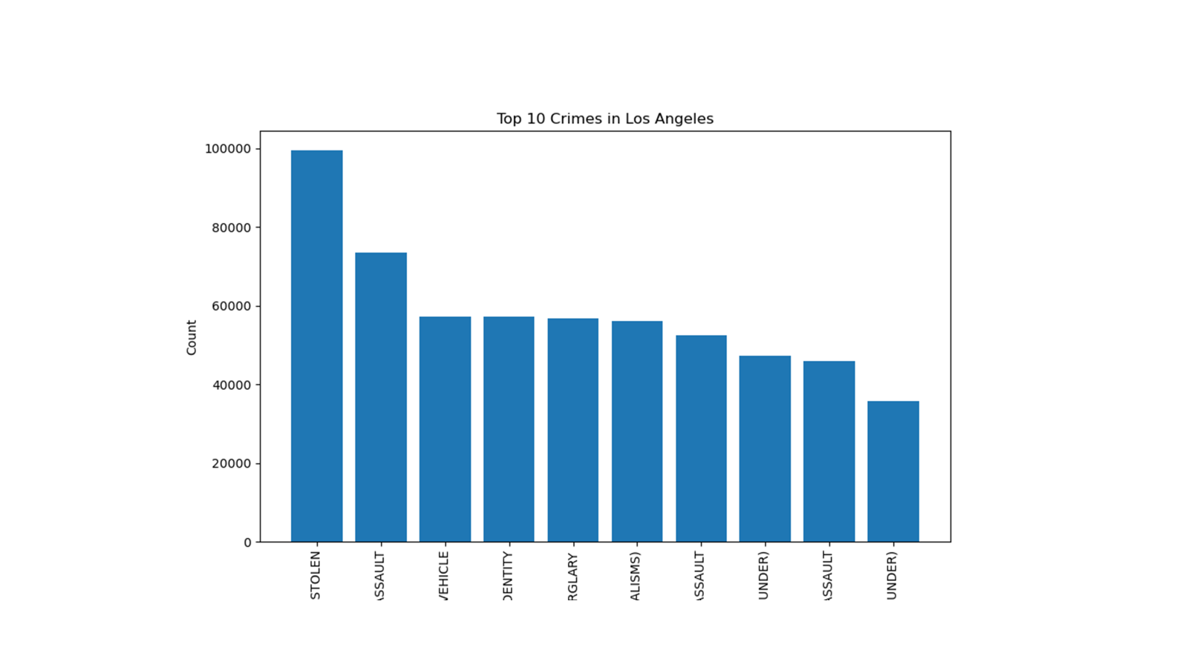
Top 10 crime types in la

Slide 16
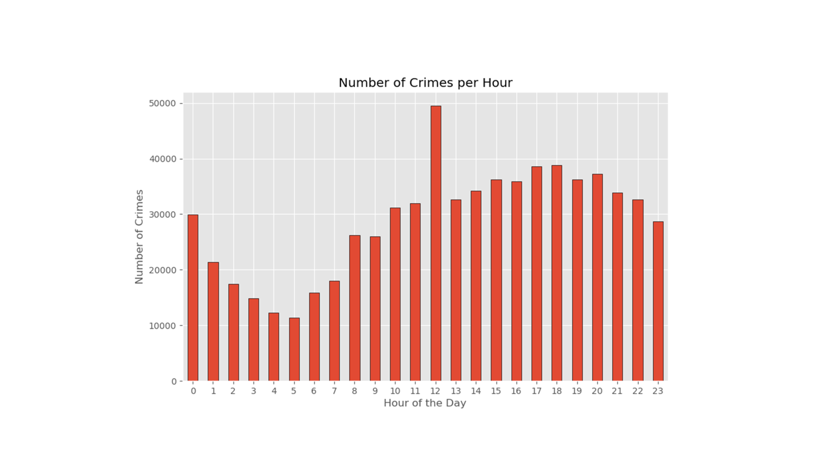
24 Hour Crime distribution

Slide 17
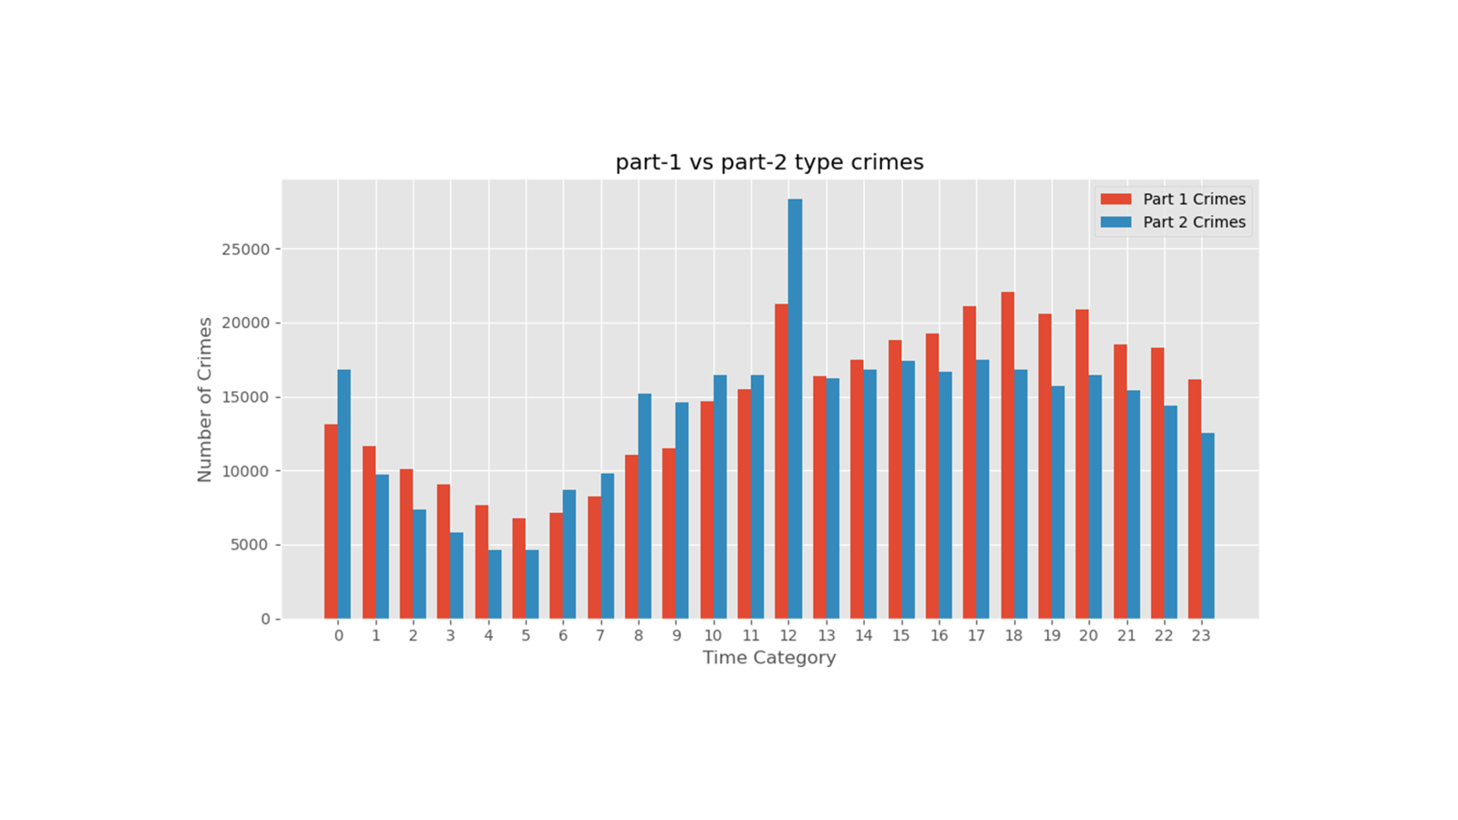
PartI and partii type crimes

Slide 18
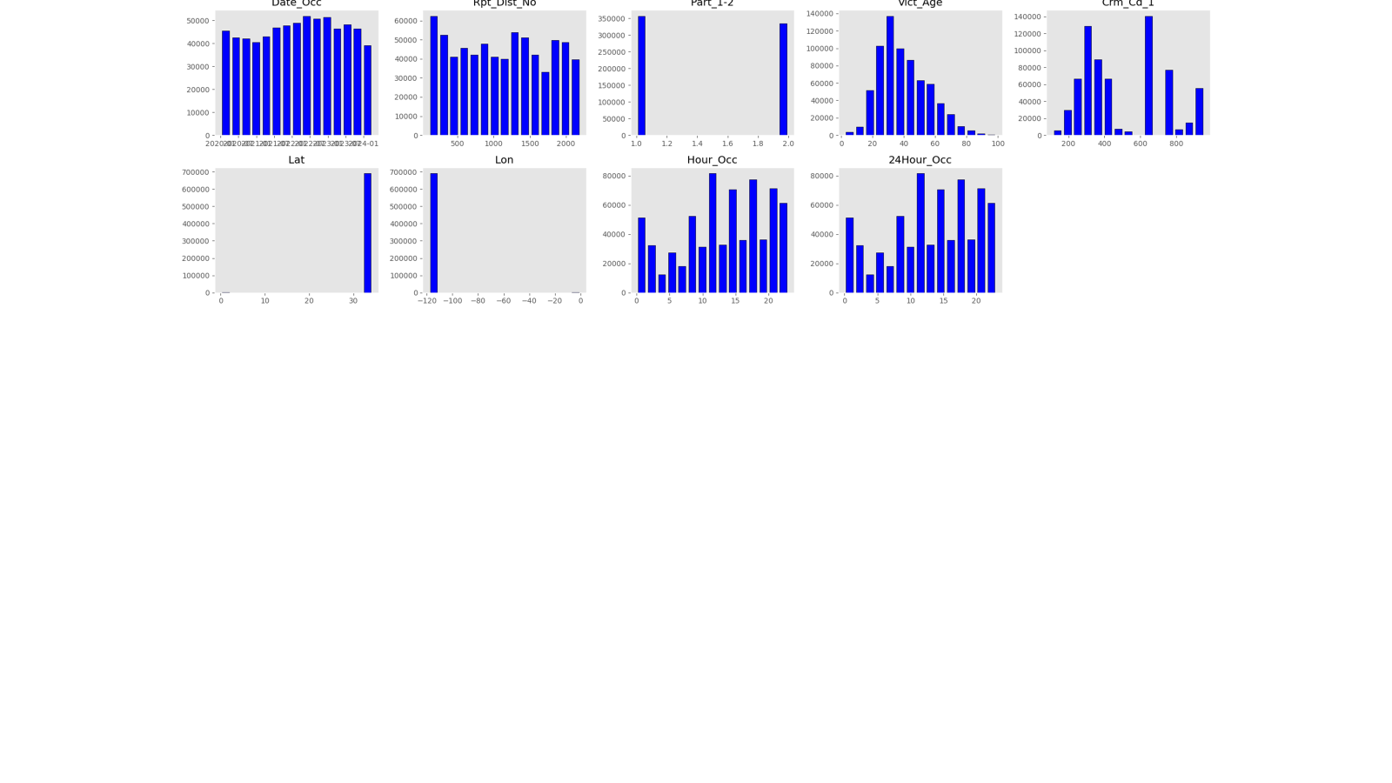
Charts at Glance

Slide 19

Machine learning models

Slide 20
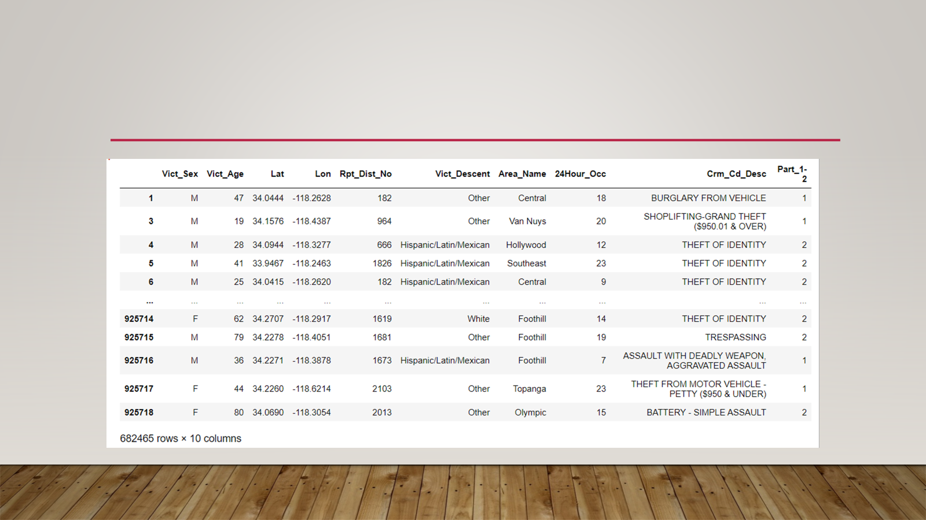
Initial data

Slide 21
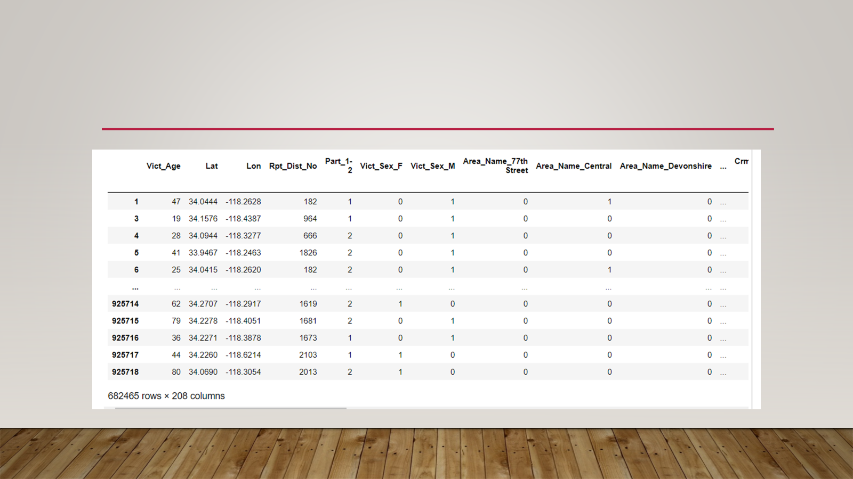
Hot encoding

Slide 22
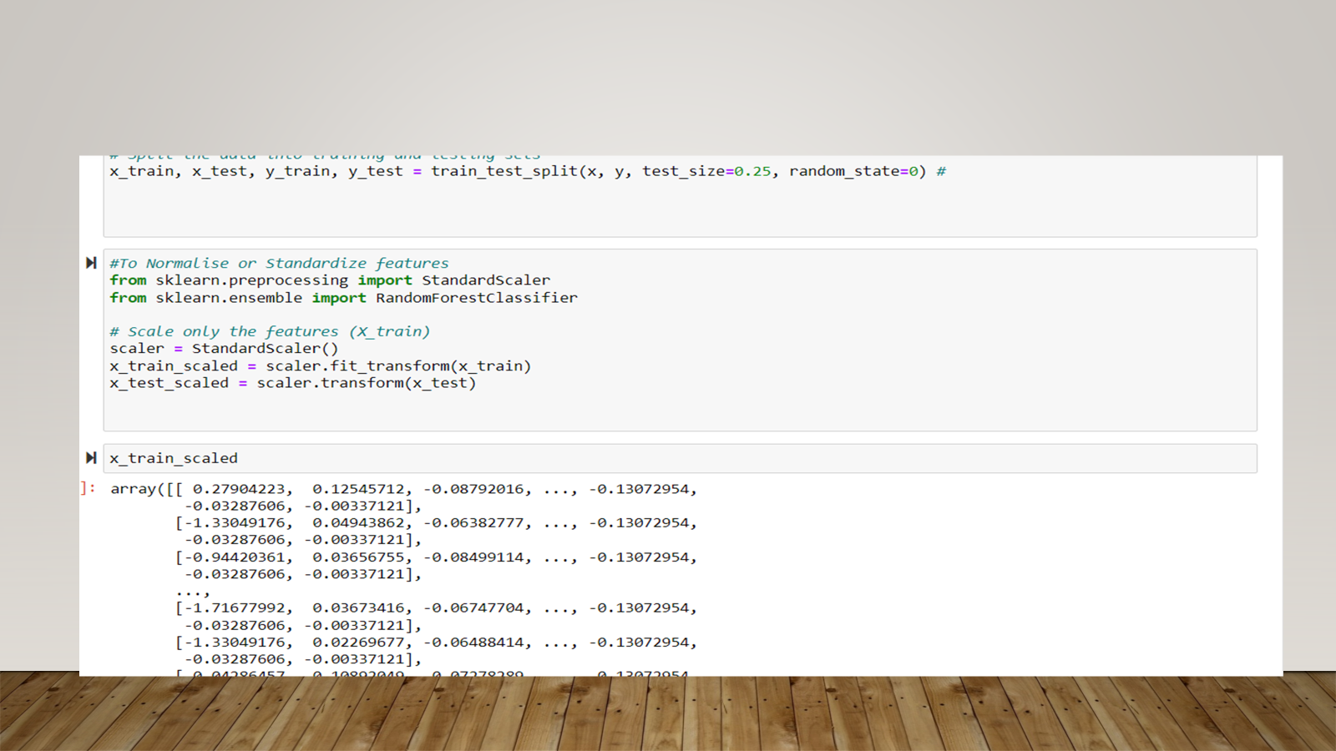
scaling

Slide 23
Models Evaluation
Decision Tree model
dtc_model_score = 0.9999
Random Forest Model
rfc_model_score = 0.9998
Linear Regression for Classification
lr_model_score = 0.9999
Super Vector for Classifier
svc_model_score = .9994

Slide 24
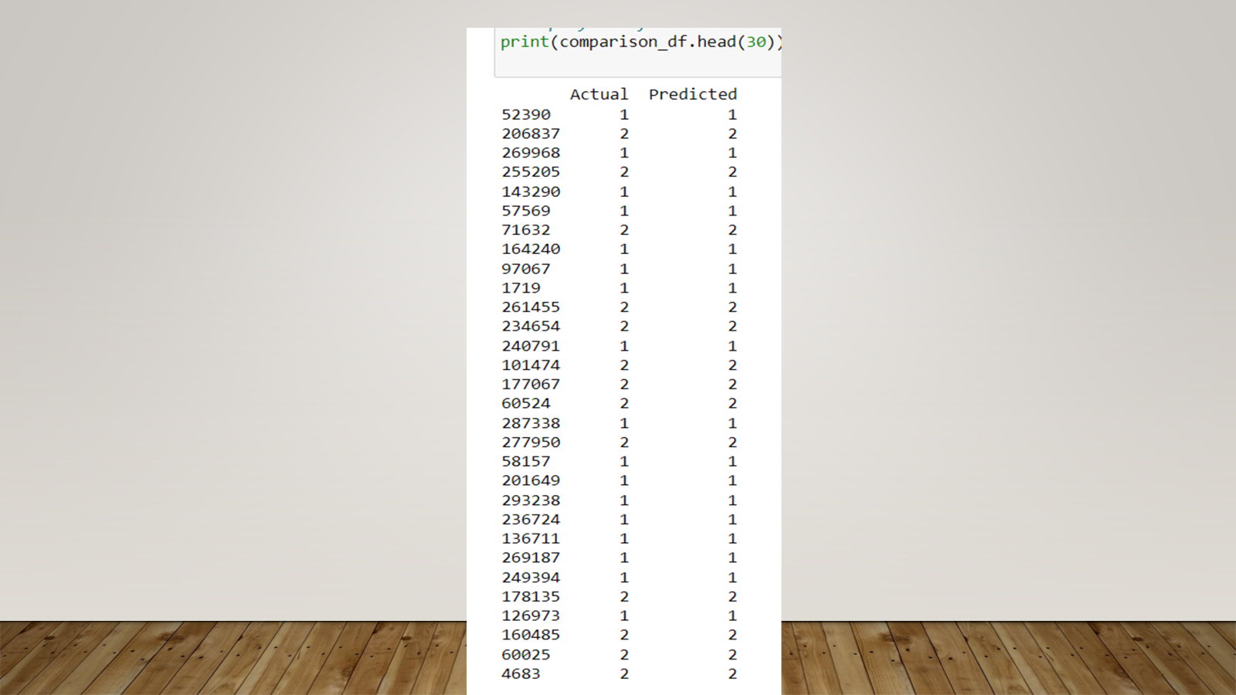
Actual vs Predicted

Slide 25
Interactive Map Process
Cleaned Data in Jupyter notebook then exported CSV file with only area and coordinate data
Color and size changes based on amount of crimes committed in each area
When clicking on a marker, it displays the area name and count of crimes within the last 4 years

Slide 26
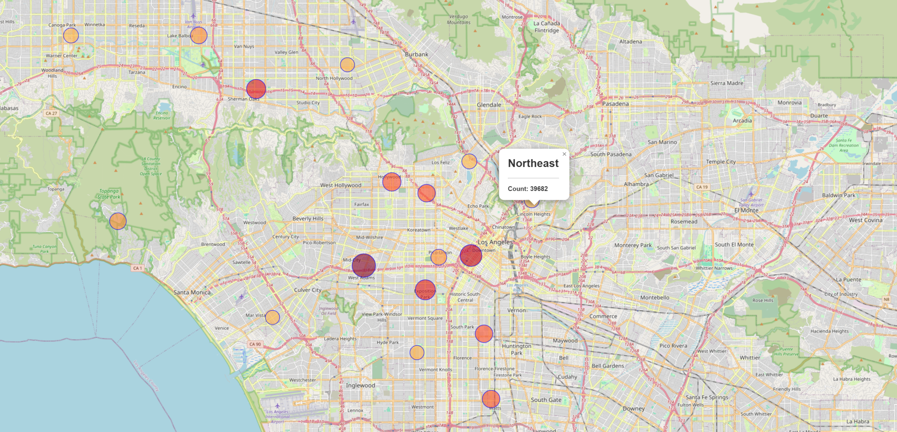
Interactive Map
Notes:
This image shows us the Interactive Map. The red and the orange circles shows the places that crimes happen. For example, Northeast has a crime count of 39,682.

